Slide 1
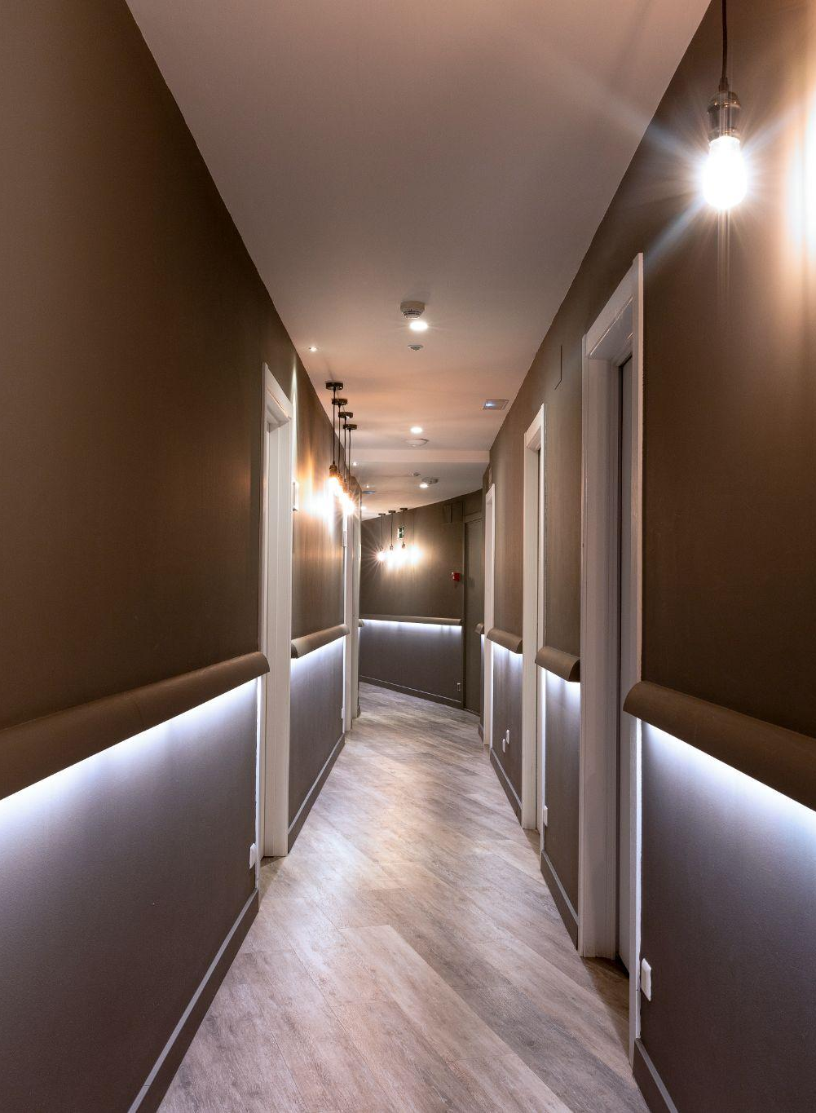
SMART ROOM ACCOMMODATION AND TRACKING SYSTEM
HOSTEL

Slide 2
Under the Guidance of : S. Radha
Done By :
Abburi Bhavya Sri (21R11A05A5)
Kosuru Bharath Kumar (21R11A05C8)
Busholla Srinath (21R11A05B5)

Slide 3
CONTENTS
Abstract
Objective
Existing System
Proposed System
Advantages of Proposed System
System Configuration
Modules

Slide 4
Abstract
Hostels play a crucial role in providing accommodations for students, faculty, and staff in educational institutions. Effective management of hostel facilities is essential to ensure optimal resource utilization, comfortable living conditions, and efficient operations. The Hostel Management System is designed to streamline room allocation, occupancy tracking, and resource planning processes. At its core, the system maintains a detailed database of the hostel's physical infrastructure, including the number of floors, rooms, and their respective dimensions. The system dynamically updates the room occupancy status, using a color-coded system to provide a clear visual representation. One of the key features of the system is the ability to accept advance bookings for rooms. The system's user-friendly web-based interface provides seamless access to hostel residents, allowing them to view room details, occupancy status, and make reservations. Administrators can easily manage room assignments and update occupancy records.

Slide 5
Objective
The system covers the essential aspects such as efficient room allocation, maintaining records, fee management, handling maintenance requests and administrations.
The main objective aligns with the details mentioned in the abstract, which highlights features like room allocation, occupancy tracking, handling advance bookings and providing a user-friendly interface for residents and administrators.

Slide 6
Existing System
Spreadsheet: A basic spreadsheet can track room availability, resident information, and even bookings. This is a free option but can be time-consuming to maintain and error-prone.
Online Booking Platforms: Some online booking platforms can be used for hostel management. These might not offer features like occupancy tracking or resident information but they can handle payments

Slide 7
Proposed System
Room Allocation: Efficiently assign rooms based on preferences, size, and occupancy limits.
Occupancy Tracking: Real-time color-coded system for room availability (green = vacant, ash = full, etc.).
Booking System: Manage reservations, prevent double bookings, and optimize room utilization.
It also consists of advantages of previously existing systems.

Slide 8
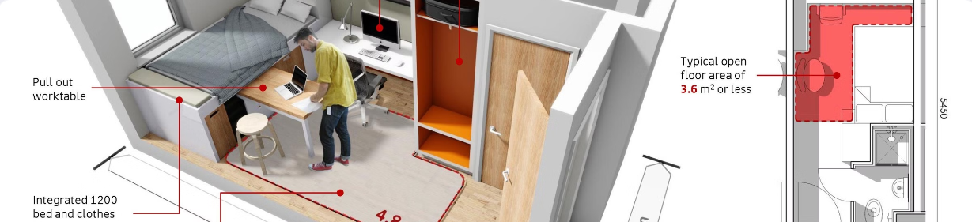
Advantages of Proposed System
Detailed database of hostel infrastructure (floors, rooms, dimensions).
Dynamic color-coded representation of room occupancy status.
Ability to accept and manage advance room bookings.
Optimal resource utilization, comfortable living, and efficient operations.
View room details, occupancy status, make reservations, report maintenance issues.

Slide 9
System Configuration
Software Requirements
Operating System : Windows
Database Management System : MySQL
Programming Language : PHP, Python, HTML, CSS, Javascript
Development Tools : Visual Studio Code
Hardware Requirements
Processor : intel i3
Memory : minimum 8GB

Slide 10
Modules
User :
User will login with a username and password.
User can select room and make payments.
Admin :
Admin will login with a username and password.
Admin can manage and update the room allocations .
Server :
User and Admin information including fee transactions will be stored.
Information about hostel infrastructure.

Slide 11
References
https://insider.in/hyderabad
https://github.com/topics/hostel-management-system
https://www.ijraset.com/research-paper/hostel-management-system-hms

Slide 12
Thank
You!

